Slide 1
Knowledge Representation and Reasoning Part-II

Slide 2
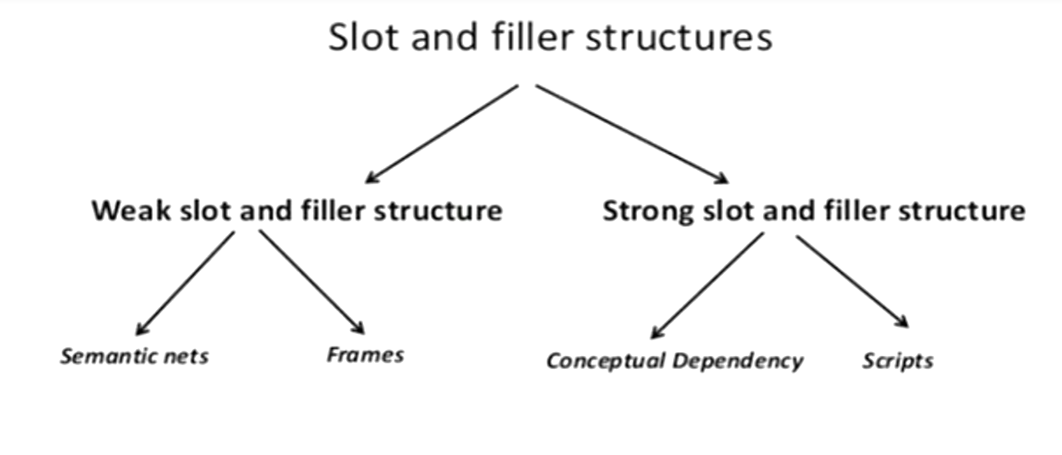

Slide 3
WEAK SLOT-AND-FILLER STRUCTURES
The structures that support property inheritance along instance and is a
links are called slot-and-filler structures.
These structures are useful for support of other reasons besides
property inheritance:
It indexes assertions by the entities they describe. The binary predicates are indexed by their first argument. So retrieving the value for a particular attribute of an object is fast.
It is easy to describe properties of objects which requires some higher
order mechanisms in purely logic based system.
It is a form of object oriented programming. So it has all advantages
that such systems have like modularity, inheritance, ease of use, etc.

Slide 4
These structures do not say much about the specific knowledge these should contain. So they are called as “knowledge-poor” or “weak-slot-and-filler structures”.
These structures include semantic networks and frames.

Slide 5
2. Semantic Network Representation
In Semantic networks, you can represent your knowledge in the form of graphical networks.
This network consists of nodes representing objects and arcs which describe the relationship between those objects.
Also, it categorizes the object in different forms and links those objects. This representation consists of two types of relations:
IS-A relation (Inheritance): Child is a subclass of parent class
Has–A relation(Composition)

Slide 6
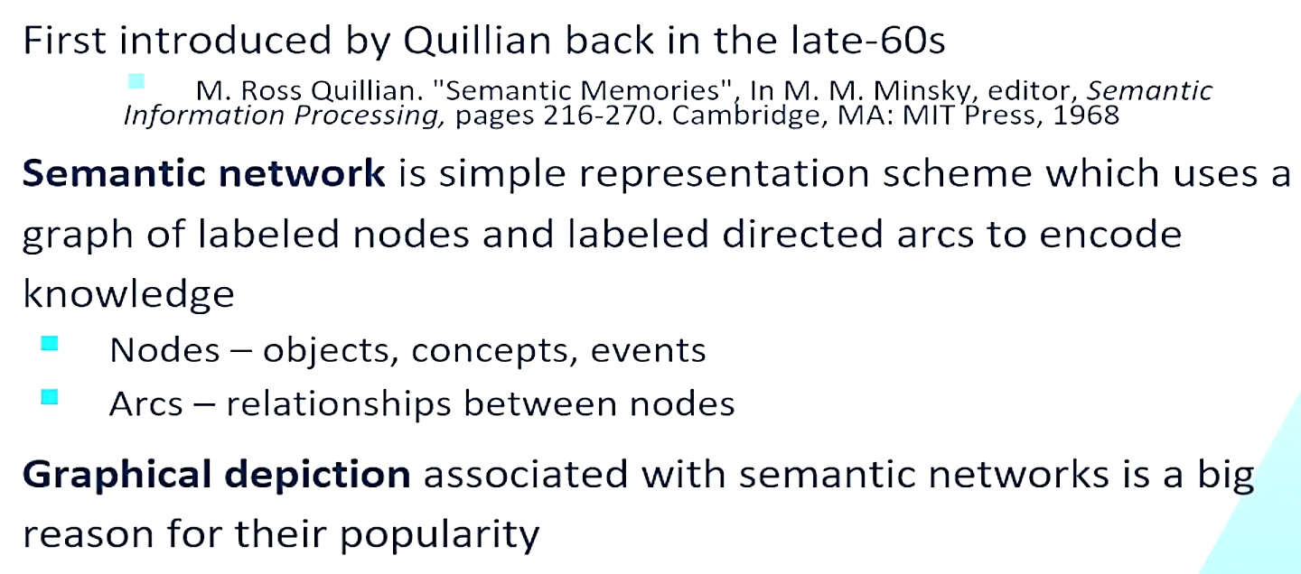

Slide 7
Consider the following sentences:
Clyde and Nellie are elephants.
Nellie likes apples.
All elephants are mammals.
All elephants are large in size and grey colored.
All mammals and reptiles are animals.
Mammals have head.
Represent the knowledge in the form of semantic networks.

Slide 8
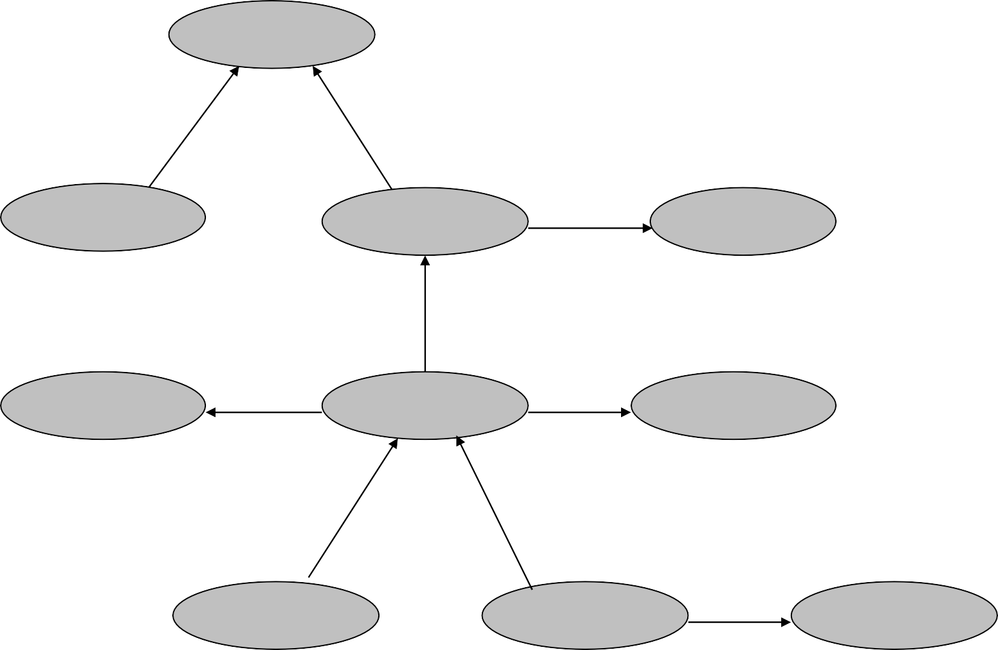
Consider the following sentences:
Clyde and Nellie are elephants.
Nellie likes apples.
All elephants are mammals.
All elephants are large in size and grey colored.
All mammals and reptiles are animals.
Mammals have head.
Represent the knowledge in the form of semantic networks.
animal
isa
isa
reptile
has_part
mammal
head
isa
large
size
elephant
colour
grey
instance_of
instance_of
Clyde
Nellie
likes
apples

Slide 9
SEMANTIC NETWORK EXAMPLE 2
Represent following KB as semantic networks.
Tom is a cat.
Tom caught a bird.
Tom is owned by John.
Tom is ginger in colour.
Cats like cream.
The cat sat on the mat.
A cat is a mammal.
A bird is an animal.
All mammals are animals.
Mammals have fur.

Slide 10
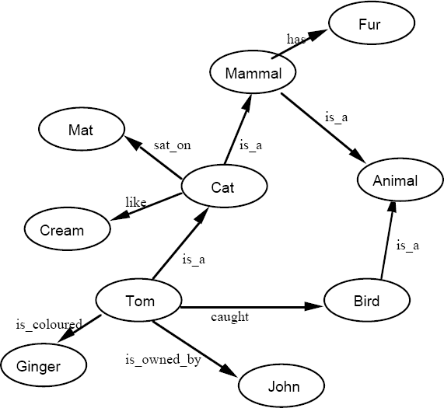
Represent following KB as semantic networks.
Tom is a cat.
Tom caught a bird.
Tom is owned by John.
Tom is ginger in colour.
Cats like cream.
The cat sat on the mat.
A cat is a mammal.
A bird is an animal.
All mammals are animals.
Mammals have fur.

Slide 11
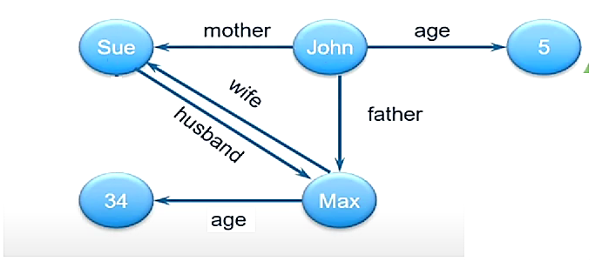
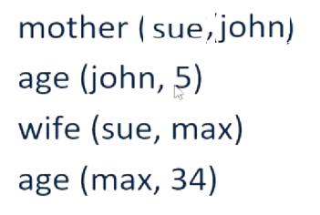

Slide 12
REPRESENTING NON-BINARY PREDICATES RELATIONS
Semantic nets are natural ways of representing
binary predicates of predicate logic like:
Team(Pee-Wee-Resse,Brooklyn Dodgers)
Uniform_color(Pee-Wee-Resse,blue)
Unary predicates can be converted in binary predicates using instance and is a relations.
For example man(marcus) can be converted into semantic network by representing it as instance(marcus,man)
Three or more arity predicates can be converted into binary form by creating new objects representing the entire predicate statement and then representing relationships of all old objects with this new object.

Slide 13
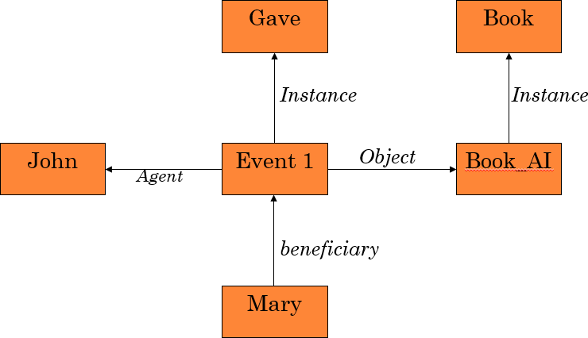
REPRESENTING NON-BINARY PREDICATES RELATIONS CONTD..
John gave Mary the AI book

Slide 14
Advantages:
Semantic networks are a natural representation of knowledge.
Also, it conveys meaning in a transparent manner.
These networks are simple and easy to understand.
Disadvantages:
Semantic networks take more computational time at runtime we need to
traverse the complete network tree to answer some questions..
Also, these are inadequate as they do not have any equivalent quantifiers e.g.,
for all, for some, none etc.
These networks are not intelligent and depend on the creator of the system.
Semantic networks do not have any standard definition for the link names.

Slide 15
3. Frame Representation
A frame is a record like structure that consists of a collection of attributes and
values to describe an entity in the world.
These are the AI data structures that divides knowledge into substructures by
representing stereotypes situations.
Basically, it consists of a collection of slots and slot values of any type and size.
Slots have names and values which are called facets.

Slide 16
Frames are a variant of semantic networks
All the information relevant to a concept is stored in a single complex entity called a frame.
Superficially, frames look like record data structures or class.
class Book { Person author; String title; int price;
}
A single frame is rarely useful.
We build a collection of frames called frame systems that are connected by virtue of the fact that the value of an attribute of one frame is another frame.

Slide 17
In frame-based systems we refer to
objects – Mammal, Elephant, and Nellie;
slots – properties such as color and size;
slot-values – values stored in the slots, e.g. grey and
large.
Slots and the corresponding slot-values are inherited through the class hierarchy

Slide 18
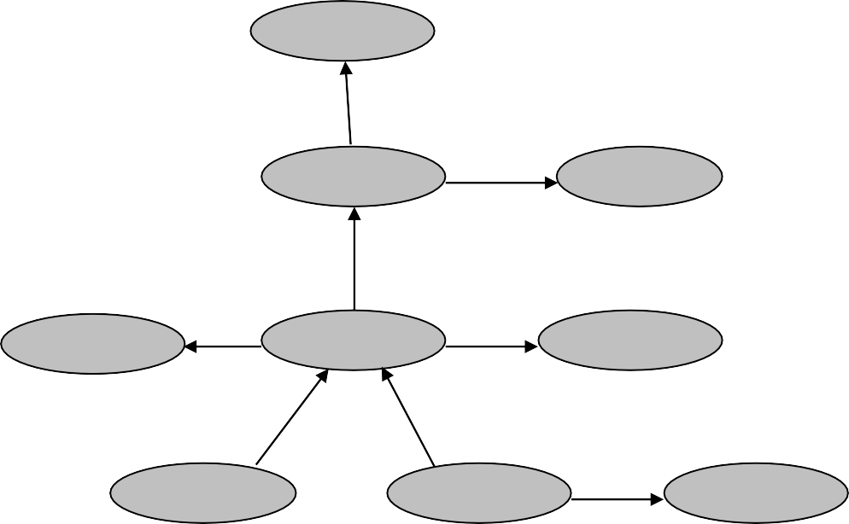
FRAMES - EXAMPLE
The previous example can be also represented as
frames:
Mammal:
subclass: has-part:
Animal head
animal
isa
Elephant:
has_part
subclass: colour: size:
Mammal grey large
mammal
head
isa
Nellie:
large
size
elephant
colour
grey
instance: likes:
Elephant apples
instance_of
instance_of
Clyde:
Clyde
Nellie
likes
apples
instance: Elephant

Slide 19
FRAMES – EXAMPLE CONTD....
The above frame system can also be represented as:
Animal
Mammal
subclass: Animal
has-part: head
 | Nellie
 | Instance: Elephant
 | likes: apples
Elephant
subclass: Mammal
colour: grey
size: large
Clyde
Instance: Elephant

Slide 20
Advantages:
It makes the programming easier by grouping the related data.
Frame representation is easy to understand and visualize.
It is very easy to add slots for new attributes and relations.
Also, it is easy to include default data and search for missing values.
Disadvantages:
In frame system, inference mechanism cannot be easily processed.
It has a very generalized approach.

Slide 21
4. Production Rules
In production rules, agent checks for the condition and if the condition exists then production rule fires and corresponding action is carried out.
The condition part of the rule determines which rule may be applied to a problem. Whereas, the action part carries out the associated problem-solving steps. This complete process is called a recognize-act cycle.
The production rules system consists of three main parts:
The set of production rules
Working Memory
The recognize-act-cycle
Example:
IF (at station AND train arrives) THEN action (get into the train) IF (on the train AND empty seat) THEN action (sit down).
IF (on train AND unpaid) THEN action (pay charges).
IF (train arrives at destination) THEN action (get down from the train).

Slide 22
The working memory contains the description of the current state of problems- solving and rule can write knowledge to the working memory. This knowledge match and may fire other rules.
If there is a new situation (state) generation, then multiple production rules may be fired together, this is called conflict set. In this situation, the agent needs to select a rule from these sets, and it is called a conflict resolution.

Slide 23
Advantages of Production rule:
The production rules are expressed in natural language.
The production rules are highly modular, so we can easily remove, add or
modify an individual rule.
Disadvantages of Production rule:
Production rule system does not exhibit any learning capabilities, as it does not store the result of the problem for the future uses.
During the execution of the program, many rules may be active hence rule- based production systems are inefficient.

